Slide 1
《算法分析与设计》
Analysis and Design of Computer Algorithms
中南大学信息科学与工程学院
School of Information Science and Engineering
Central South University
主讲：李敏
联系方式：limin@mail.csu.edu.cn
csu.limin@gmail.com

Slide 2
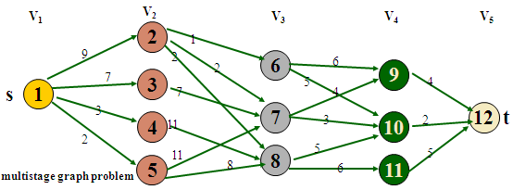
Dynamic Programming
动态规划(dynamic programming)是运筹学的一个分支，是求解决策过程(decision process)最优化的数学方法。
20世纪50年代初美国数 学家R.E.Bellman等人提出了著名的最优化原理(principle of optimality)，把多阶段过程转化为一系列单阶段问题，利用各阶段之间的关系，逐个求解，创立了解决这类过程优化问题的新方法——动态规划。
Notes:
They both solve problems by dividing a problem into small subproblems.
But D&C partition the problem into independent subproblems; in contrast, dynamic programming is applicable when the subproblems are not independent, I.e., when subproblems share subsubproblems. In this context, a dandc algorithm does more work than necessary, repeatedly solving the common subproblems, while a DP algorithm solves every subsubproblem just ONCE and then saves its answer in a table, thereby avoiding the work of recomputing the answer every time the subproblem is encountered.

Slide 3
Dynamic Programming
动态规划是信息学竞赛中选手必须熟练掌握的一种算法,他以其多元性广受出题者的喜爱. 动态规划成为信息学奥赛的必考算法之一。
动态规划问世以来，在经济管理、生产调度、工程技术和最优控制等方面得到了广泛的应用。例如最短路线、库存管理、资源分配、设备更新、排序、装载等问题。
Notes:
They both solve problems by dividing a problem into small subproblems.
But D&C partition the problem into independent subproblems; in contrast, dynamic programming is applicable when the subproblems are not independent, I.e., when subproblems share subsubproblems. In this context, a dandc algorithm does more work than necessary, repeatedly solving the common subproblems, while a DP algorithm solves every subsubproblem just ONCE and then saves its answer in a table, thereby avoiding the work of recomputing the answer every time the subproblem is encountered.

Slide 4
Dynamic Programming
Main idea:
  solve several smaller (overlapping) subproblems
  record solutions in a table so that each subproblem is only solved once
  final state of the table will be (or contain) solution
Notes:
They both solve problems by dividing a problem into small subproblems.
But D&C partition the problem into independent subproblems; in contrast, dynamic programming is applicable when the subproblems are not independent, I.e., when subproblems share subsubproblems. In this context, a dandc algorithm does more work than necessary, repeatedly solving the common subproblems, while a DP algorithm solves every subsubproblem just ONCE and then saves its answer in a table, thereby avoiding the work of recomputing the answer every time the subproblem is encountered.

Slide 5
Dynamic programming vs. divide-and-conquer
Divide-and-conquer algorithms split a problem into separate subproblems, solve the subproblems, and combine the results for a solution to the original problem.
Divide-and-conquer algorithms can be thought of as top-down algorithms
In contrast, a dynamic programming algorithm proceeds by solving small problems, then combining them to find the solution to larger problems
Dynamic programming can be thought of as bottom-up
Store and not store solutions to subproblems

Slide 6
Example: Fibonacci numbers
Recall definition of Fibonacci numbers:
  f(0) = 0
  f(1) = 1
  f(n) = f(n-1) + f(n-2)
Computing the n^{th} Fibonacci number recursively (Top-Down):
f(n)
f(n-1) + f(n-2)
f(n-2) + f(n-3) f(n-3) + f(n-4)
...

Slide 7
Top-Down
F6
F (n)
{ if(n<=1)
return 1;
else
return F (n-1)+ F(n-2); }
F5
F4
F4
F3
F3
F2
F3
F2
F2
F1
F0
F2
F1
F1
F2
F0
F1
F0
F1
F1
F1
F0
F1
F0

Slide 8
Example: Fibonacci numbers
  Computing the n^{th} fibonacci number using bottom-up iteration:
f(0) = 0
f(1) = 1
f(2) = 0+1 = 1
f(3) = 1+1 = 2
f(4) = 1+2 = 3
f(5) = 2+3 = 5
…
f(n-2) =
f(n-1) =
f(n) = f(n-1) + f(n-2)
ALGORITHM Fib(n)
f[0] ← 0, f[1] ← 1
for i←2 to n do
f[i] ← f[i-1] +f[i-2]
return f[n]

Slide 9
动态规划的思想及特性
可以使用动态规划的问题特点
  一个大问题可以划分为若干个子问题
  子问题：性质一样但是规模变小的问题
  最优子结构
  在计算时子问题有交叠。(交叠子结构)
记忆化思想
  对较小的子问题进行一次求解，并把结果记录下来，然后利用较小问题的解，求解出较大问题的解，直到求解出最大问题的解。[同一件事情不做第二次]

Slide 10
最优性原理(Principle of Optimality)
  最优性原理：无论过程的初始状态和初始决策是什么，其余的决策都必须相对于初始决策所产生的状态构成一个最优决策序列。
  不管前面的策略如何，此后的决策必须基于当前状态（由上一次决策产生）的最优决策。
  最优子结构性质：原问题的最优解包含了其子问题的最优解，即最优化原理成立。
  一般来说，如果所求解问题对于最优性原理成立，则说明用动态规划方法有可能解决该问题。而解决问题的关键在于获取各阶段问的递推关系式。

Slide 11
最优子结构性质
1
2
4
4
2
3
1
6
1
4
3
3
4
5
1
2
4
4
2
原问题的最优解
1
6
1
2
4
2
1
4
包含子问题的最优解
1
3

Slide 12
动态规划的相关概念
1、阶段：把一个问题的过程，恰当地分为若干个相互联系的阶段，以便于按一定的次序去求解。
描述阶段的变量称为阶段变量（k)。k=1,2 ,3, …，n
阶段的划分，一般是根据时间和空间的自然特征来进行的，但要便于问题转化为多阶段决策。
2、状态：表示每个阶段开始所处的自然状况或客观条件。通常一个阶段有若干个状态，描述过程状态的变量称为状态变量s_{k} (表示第k阶段的状态变量 )。
状态变量的取值有一定的允许集合或范围，此集合称为状态允许集合S _{K} ={s₁,s₂, …, s _{k} ,…}
。

Slide 13
3、决策：表示当过程处于某一阶段的某个状态时，可以作出不同的决定，从而确定下一阶段的状态，这种决定称为决策。
描述决策的变量，称为决策变量。
常用u_{k}（s_{k}）表示第k阶段当状态为s_{k}时的决策变量。
决策变量是状态变量的函数。可用一个数、一组数或一向量（多维情形）来描述。

Slide 14
4、多阶段决策过程
无后效性(马尔可夫性)
如果某阶段状态给定后，则在这
个阶段以后过程的发展不受这个
阶段以前各段状态的影响
可以在各个阶段进行决策，去控制过程发展的多段过程；
其发展是通过一系列的状态转移来实现的；
系统在某一阶段的状态转移不但与系统的当前的状态和决策有关，而且还与系统过去的历史状态和决策有关。【具有无后效性】

Slide 15
数字三角形问题
问题描述
给定一个具有N层的数字三角形，从顶至底有多条路径，每一步可沿左斜线向下或沿右斜线向下，路径所经过的数字之和为路径得分，请求出最小路径得分。
2
6 2
1 8 4
1 5 6 8
图 数字三角形

Slide 16
2
6 2
1 8 4
1 5 6 8
图 数字三角形
状态表示：
用二元组D(X,y)描述问题，D(X,y)表示从顶层到达第X层第y个位置的最小路径得分。
最优子结构性质：容易看出，D(X,y)的最优路径Path(X,y)一定包含子问题D(X-1,y)或D(X-1,y-1)的最优路径。
否则，取D(X-1,y)和D(X-l,y-1)的最优路径中得分小的那条路径加上第X层第y个位置构成的路径得分必然小于Path(X,y)的得分，这与Path(X,y)的最优性是矛盾的。

Slide 17
递归关系：
D(X,y)＝min{D(X-1,y)，D(X-1,y-1}+a(X,y)
D(1,1)＝a(1,1)
其中，a(X,y)为第X层第y个位置的数值。
在上述递归关系中，求D(X,y)的时候，先计算D(X-1,y)和D(X-1,y-1)，下一步求D(X，y+1)时需要D(X-1，y+1)和D(X-1，y)，但其中D(X-1，y)在前面已经计算过了。于是，子问题重叠性质成立。
原问题的最小路径得分可以通过比较D(N,i)获得，其中i＝1，2，…，N。
此思路为从顶层开始，逐步向下至底层来求出原问题的解。
可以从相反的方向考虑？

Slide 18
2
6 2
1 8 4
1 5 6 8
图 数字三角形
仍用二元组D(X,y)描述问题，D(X,y)表示从第X层第y个位置到达底层的最小路径得分。原问题的最小路径得分即为D(1,1)。
最优子结构性质：显然，D(X,y)的最优路径Path(X,y)一定包含子问题D(X+1,y)或D(X+1,y+1)的最优路径，否则，取D(X+1,y)和D(X+1,y+1)的最优路径中得分小的那条路径加上第X层第y个位置构成的路径得分必然小于Path(X,y)的得分，这与Path(X,y)的最优性矛盾。

Slide 19
递归关系：
D(X,y)＝min{D(X+1,y),D(X+1,y+1)}+a(X,y)
D(N,k)＝a(N,k)，k＝1，…，N
其中，a(X，y)为第X层第y个位置的数值。
D(X,y)表示从第X层第y个位置到达底层的最小路径得分。原问题的最小路径得分即为D(1,1)。

Slide 20
动态规划的几个要点：
主题思想：
  同一件事不做二次。
状态表示：
  用问题的某些特征参数描述当前问题。
  将问题发展到各个阶段时所处于的各种客观情况用不同的状态表示出来。
确定决策并写出状态转移方程：
  状态值之间的递推关系（根据上一阶段的状态和决策来导出本阶段的状态）
  边界条件；递推顺序
实现方式：自顶向下；自底向上

Slide 21
Three basic components
The development of a dynamic programming algorithm has three basic components:
  A recurrence relation (for defining the value/cost of an optimal solution);
  A tabular computation (for computing the value of an optimal solution);
  A backtracing procedure (for delivering an optimal solution).

Slide 22
Examples of Dynamic Programming Algorithms
  Computing binomial coefficients
  multistage graph problem
  Longest path in DAG
  Edit distance
  Knapsack
  Chain matrix multiplication
  all-pairs shortest paths
  Traveling salesman

Slide 23
例1：计算二项式系数
二项式系数(Binomial Coefficient )
  是n元素集合中k个元素组合的数量(0≤k ≤n)，记作C(n.k)或者C_{n}^{k}，来源于二项式公式：
  (a+b)^{n}=C_{n}⁰a^{n}+…+C_{n}^{i}a^{n-i}b^{i}+…+C_{n}^{n}b^{n}
递推关系式：
  当n>k>0时，C_{n}^{k}=C_{n-1}^{k-1}+C_{n-1}^{k}
  其他， C_{n}⁰=C_{n}^{n}=1
  或者写成：C(n,k)=C(n-1,k-1)+C(n-1,k)，n>k>0
  C(n,0)=C(n,n)=1
如：C(2,1)=C(1,0)+C(1,1)=1+1=2
  C(3,1)=C(2,0)+C(2,1)=1+2=3 …

Slide 24
Dynamic programming solution:
Record the values of the binomial coefficients in a table of n+1 rows and k+1 columns, numbered from 0 to n and 0 to k respectively.
0 1 2 3 … k-1 k
0 1
1 1 1
2 1 1
3 1 1
…
k 1 1
…
n-1 1
n 1

Slide 25
Dynamic programming solution:
Record the values of the binomial coefficients in a table of n+1 rows and k+1 columns, numbered from 0 to n and 0 to k respectively.
0 1 2 3 … k-1 k
0 1
1 1 1
2 1 2 1
3 1 1
…
k 1 1
…
n-1 1
n 1

Slide 26
Dynamic programming solution:
Record the values of the binomial coefficients in a table of n+1 rows and k+1 columns, numbered from 0 to n and 0 to k respectively.
0 1 2 3 … k-1 k
0 1
1 1 1
2 1 2 1
3 1 3 3 1
…
k 1 1
…
n-1 1
n 1

Slide 27
Dynamic programming solution:
Record the values of the binomial coefficients in a table of n+1 rows and k+1 columns, numbered from 0 to n and 0 to k respectively.
0 1 2 3 … k-1 k
0 1
1 1 1
2 1 2 1
3 1 3 3 1
…
k 1 1
…
n-1 1 C(n-1,k-1) C(n-1,k)
n 1

Slide 28
Dynamic programming solution:
Record the values of the binomial coefficients in a table of n+1 rows and k+1 columns, numbered from 0 to n and 0 to k respectively.
0 1 2 3 … k-1 k
0 1
1 1 1
2 1 2 1
3 1 3 3 1
…
k 1 1
…
n-1 1 C(n-1,k-1) C(n-1,k)
n 1 C(n,k)

Slide 29
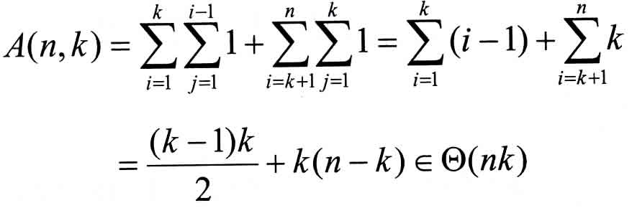

二项式系数算法
算法 Binomial(n,k)
//用动态规划算法计算C(n,k)
//输入：一对非负整数n≥k ≥0
//输出：C(n,k)的值
for(i←0;i<=n;i++)
for(j←0;j<=min(i,k);j++)
if(j=0 || j=k) C[i,j]=1;
else
C[i,j]←C[i-1,j-1]+C[i-1,j];
Return C[n,k];
思考：利用公式
1、C(n,k)=n!/k!(n-k)!
2、C(n,k)=n(n-1)…(n-k+1)/k!
与动态规划计算比较，那一个的效率高？

Slide 30
例2：多段图(multistage graph problem)
多段图G＝(V，E)是—个有向图。它具有如下特性：
  图中的结点被划分成k≥ 2个不相交的集合V_{i} ,1≤i≤k,其中V₁和V_{k}分别只有一个结点s(源点)和t(汇点)。
  图中所有的边<u,v>均具有如下性质：若u∈V_{i} ，则v ∈ V_{i+1} ,1≤i≤k,且每条边<u,v>均附有成本c(u，v)。
  从s到t的一条路径成本是这条路径上边的成本和。
  多段图问题是求由s到t的最小成本路径。

Slide 31
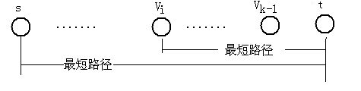
1）证明多段图满足最优化原理。
假设s v_{i},…,v_{k-1} ,t是一条由s到t的最短路径，如图所示。
s
v_{i}
q_{i+1}
q_{k-1}
t
……….
……
假定从源点s开始，已作出了到结点v_{i}的决策，下面的子问题是找出一条由v_{i}到t的最短路径。
显然子问题的最优解是v_{i}，…，v_{k-1}，t。

Slide 32
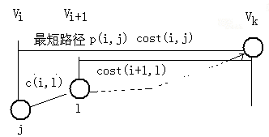
2）写出动态规划方程
设P(i，j)是一条从V_{i}中的结点j到汇点t的最小成本路径，
COST(i，j)是这条路的成本。
则从V_{i}中节点j到t的最小代价为：
cost(i,j)=min{cost(i+1,l)+c (j,l) }, l∈V_{i+1} ， j∈V_{i}
cost(i+1，l)是从V_{i+1}中节点l 到t的最小代价，

Slide 33
COST(3，6)＝min{6+COST(4，9)，5+COST(4，10)}＝7
COST(3，7)＝min{4+COST(4，9)，3+COST(4，10)}＝5
COST(3，8)＝7
COST(2，2)=min{4十COST(3，6)，2+COST(3，7)，1+COST(3，8)}=7
COST(2，3)＝9
COST(2，4)=18
COST(2，5)＝15
COST(1，1)＝min{9+COST(2，2)，7+COST(2，3)，3+COST(2，4)，
2+COST(2，5)}＝16
于是由s到t的最小成本路径的成本为16。

Slide 34
3）构造最优解
如果在计算每一个COST(i，j)的同时，记下每个结点j所作的决策(即，使c(j，l)+COST(i+1，l)取最小值的j的后继节点r)，设它为D(i，j)，则可容易地求出这条最小成本路径。
D(3，6)＝10 D(3，7)＝10 D(3，8)＝10
D(2，2)=7 D(2，3)=6 D(2，4)＝8 D(2，5)＝8
D(1，1)＝2
P(1)＝1， P(5)＝12
P(2)= D(1，P(1) )=2,
P(3)=D(2,P(2) ) = D(2, 2 )=7,
P(4)＝D(3，P(3))=D(3，7)＝10

Slide 35
多段图的向前处理算法
procedure FGRAPH(G，k，n，P)
{//G有n个结点的k段图。E是边集，c[i，j]是边<i,j>的成本。
P[1：k]是最小成本路径。//
COST[n]， D[n一1]，P[k]，r，j，k，n
COST[n]← 0
for j←n-1to 1 by -1 do //计算COST[j]//
{设r是一个这样的结点，(j，r)∈E且使c[j，r]+COST[r]取最小值
COST[j]←c[j，r]+COST[r]
D[j]←r
} //向前对j-1进行决策//
P[1]←1
P[k]←n
for j←2 to k-1 do //找路径上的第j个节点//
P[j]←D [ P[j-1] ]
}

Slide 36
向后递推规划方法
s
V_{i-1}
v_{i}
t
c[i-1,l]
……….
l
j
……….
Cost[i-1,l]
Cost[i,j]
Cost[k,n]
Cost[1,s]=0已知 可求得Cost[2,j]
对于任意的cost[i,j]，有
cost[i,j]=min{cost[i-1,l]+c[l,j] } j∈V_{i} ，l ∈V_{i-1}
最后求出s,…..v_{i}，…，v_{k-1}，t。

Slide 37
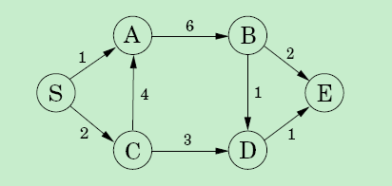
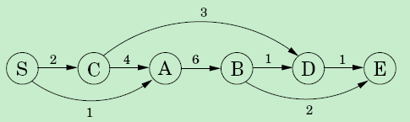
例3： Longest path in DAG
  Problem:
  Given a weighted directed acyclic graph G=(V, E), a vertex v, where each edge is assigned an integer weight, find a longest path in graph G.

Slide 38
Longest path in DAG
dilg(v): the longest path ending with v.
dilg(D), dilg(B), dilg(C)
dilg(D)=max{dilg(B)+1, dilg(C)+3}
For any vertex v,
dilg(v)=max_{(u,v)∈E}{dilg(u)+w(u, v)}

Slide 39
Longest path in DAG
Dplongestpath(G)
Initialize all dilg(.) values to ∞;
Let S be the set of vertices with indegree=0;
For each vertex v in S do
dilg(v)=0;
4. For each v∈V\S in Topological Sorting order do
dilg(v)=max_{(u,v)∈E}{dilg(u)+w(u, v)}
5. Return the dilg(.) with maximum value.

Slide 40
Longest path in DAG
The algorithm only get the value of the longest path.
Problem: How to find such path?
Dplongestpath(G)
Initialize all dilg(.) values to ∞;
Let S be the set of vertices with indegree=0;
for each vertex v in S do
dilg(v)=0;
4. For each v∈V\S in Topological Sorting order do
dilg(v)=max_{(u,v)∈E}{dilg(u)+w(u, v)}
5. Return the dilg(.) with maximum value.

Slide 41
Longest path in DAG
Dplongestpath(G)
Initialize all dilg(.) values to ∞;
Let S be the set of vertices with indegree=0;
for each vertex v in S do
dist(v)=0;
4. For each v∈V\S in Topological Sorting order do
dilg(v)=max_{(u,v)∈E}{dilg(u)+w(u, v)}
let (u,v) be the edge to get the maximum
value;
dad(v)=u;
5. Return the dilg(.) with maximum value.

Slide 42


例4： Edit Distance
The distance between strings: alignment
Alignment: a way of writing the strings one above the other.
The “－”indicates a “gap”;
any number of these gap can be placed in either string.
The cost of an alignment is the number of columns in which the letters differ.

Slide 43
Edit Distance
Cost: 3
Cost: 5
The edit distance between two strings is the cost of their best possible alignment.

Slide 44
Edit Distance
Problem: Given two strings, how to get the edit distance?
Strategy 1:
get all possible alignments between two strings;
search through all of them for the best one.
Strategy 2:
Dynamic programming

Slide 45
Edit Distance
Problem: Given two strings, how to get the edit distance?
Strategy 1:
get all possible alignments between two strings;
search through all of them for the best one.
Strategy 2:
Dynamic programming

Slide 46
Edit Distance
Dynamic Programming for Edit Distance
Given two strings x[1..m], y[1..n], find the Edit Distance between x and y (E(m, n)).
What are the subproblems?
E X P O N E N T I A L
P O L Y N O M I A L
How about the edit distance between some prefix of strings.
x[1..i], y[1..j]
subproblem E(i, j)

Slide 47


Edit Distance
Subproblem E(7, 5)
subproblem E(i, j):
express E(i, j) in terms of smaller subproblems
What do we know about the best alignment between x[1..i], y[1..j]?
rightmost column

Slide 48
Edit Distance
Subproblem E[i,j] rightmost column
E(i, j) E(i-1, j)
E(i, j) E(i, j-1)
E(i, j) E(i-1, j-1)
Relationship
Relationship
Relationship
E(i,j)=1+E(i-1,j)
E(i,j)=1+E(i,j-1)
E(i,j)=1/0+E(i-1,j-1)
If x[i]=x[j] then diff(i, j)=0, otherwise diff(i, j)=1.
E(0, j)=j；E(i, 0)=i.

Slide 49
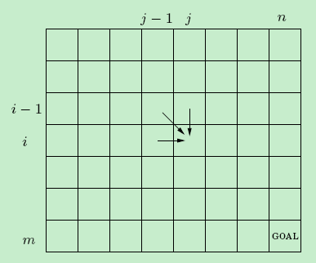
Edit Distance
The answers to all the subproblems E(i, j) form a two-dimensional table.

Slide 50
Edit Distance
DPEditDis(x[1..m], y[1..n])
For i=0 to m do
E(i, 0)=i;
2. For j=1 to n do
E(0,j)=j;
3. For i=1 to m do
for j=1 to n do
E(i,j)=min{E(i-1,j)+1, E(i,j-1)+1,
E(i-1,j-1)+diff(i, j)}
4. Return E(m,n).
Running time: O(mn)

Slide 51

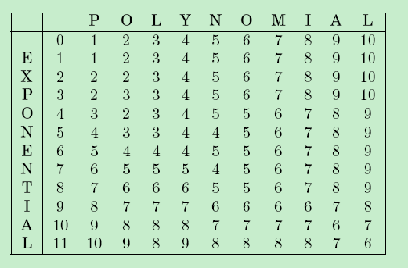
Edit Distance
Edit distance of EXPONENTIAL and POLYNOMIAL

Slide 52
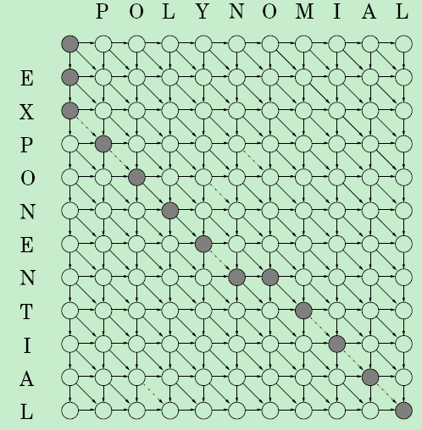
Edit Distance
Edit distance of EXPONENTIAL and POLYNOMIAL

Slide 53

Subproblems choosing
The finding of subproblems is an important step in Dynamic programming.
Commonly used methods:
The input is x1, x2, …, xn.
a subproblem is x1, x2, …, xi.
How many subproblems for this case?
O(n)

Slide 54
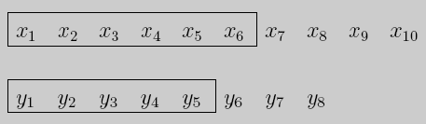
Subproblems choosing
2. The input is x1, x2, …, xn, and y1, y2,…, ym.
a subproblem is x1, x2, …, xi and y1,…, yj.
How many subproblems for this case?
O(mn)

Slide 55

Subproblems choosing
3. The input is x1, x2, …, xn.
a subproblem is xi, xi+1, …, xj.
How many subproblems for this case?
O(n²)

Slide 56
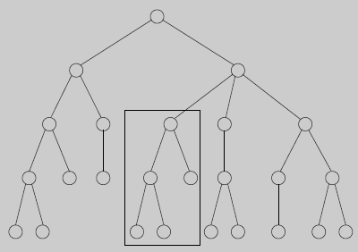
Subproblems choosing
3. The input is a rooted tree.
a subproblem is a rooted subtree.
If the tree has n nodes?
How many subproblems are there?

Slide 57

例5： Knapsack
During a robbery, a burglar finds much more loot than he had expected and has to decide what to take.

Slide 58
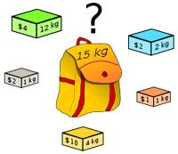
Knapsack
His bag (or .knapsack.) will hold a total weight of at most W pounds.
There are n items to pick from, of weight w1, …,wn and
value v1,…,vn.
What's the most valuable combination of items he can fit into his bag?

Slide 59
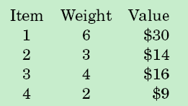
Knapsack
Two versions of the problem
each item :unlimited quantity
each item : only one
Knapsack with repetition
Knapsack without repetition
W=10

Slide 60
Knapsack
Knapsack with repetition
What are the subproblems?
smaller knapsack capacities w≤W
fewer items (for instance, items 1, 2,…,j, for j≤n).

Slide 61
Knapsack
Knapsack with repetition
smaller knapsack capacities w≤W.
K(w) = maximum value achievable with a knapsack of capacity w.
Can we express this in terms of smaller subproblems?
Assume item i (weight wi, value vi) is contained in optimal solution to K(w).
K(w) k(w-wi)
K(w)=k(w-wi)+vi

Slide 62

Knapsack
Knapsack with repetition
K(w) k(w-wi)
K(w)=k(w-wi)+vi
don't know which i
try all possibilities
K(w)
K(w-w1)
K(w-w2)
…
K(w-wn)
K(0)=0

Slide 63
Knapsack
Knapsack with repetition
DPKnapsackrepe(item1,…,item n; w1,…,wn; v1,…, vn,W）
K(0)=0;
For w=1 to W do
K(w)=max{K(w-wi)+vi, wi ≤W};
Return K(W).
Running time: O(nW)

Slide 64
Knapsack
Knapsack without repetition
What are the subproblems?
smaller knapsack capacities w≤W
fewer items (for instance, items 1, 2,…,j, for j≤n).
K(w)
K(w-wi) is the maximum one for all items.
K(w, j) = maximum value achievable using a knapsack of capacity w and items 1, …,j.

Slide 65
Knapsack
Knapsack without repetition
What are the subproblems?
K(w, j) = maximum value achievable using a knapsack of capacity w and items 1, …,j.
K(W, n) is the answer.
How to get subproblem K(w, j) in terms of smaller subproblems?
K(w,j)=max{K(w-wj, j-1)+vj, K(w,j-1)} w ≥ wj
K(w,j)=K(w,j-1)
w < wj
K(0,j)=0, K(w, 0)=0.

Slide 66
Knapsack
Knapsack without repetition
Constructing a two-dimension table with W+1 rows and n+1 columns

Slide 67
Knapsack
 | 0 | … | w-w_{j} | … | w | … | W
0 | 0 | … | 0 | … | 0 | …. | 0
： | ： | …
j-1 | 0 | … | K[w-wj, j-1] |  | K[w,j-1]
j | 0 | … |  |  | K[w, j]
n | 0 | … |  |  |  |  | goal

Slide 68
Knapsack
DPKnapsacknorepe(item1,…,item n; w1,…,wn; v1,…, vn, W)
For j=1 to n do
K(0,j)=0;
For w=0 to W do
K(w, 0)=0;
For j=1 to n do
for w=1 to W do
if wj>w then
K(w, j)=K(w, j-1);
else K(w, j)=max{K(w,j-1), K(w-wj, j-1)+vj};
4. Return K(W, n).
Running time: O(nW)

Slide 69
Knapsack
Discussion
Knapsack: NP-hard problems.
Algorithm: O(nW)
Seems like polynomial.
Knapsack problem has Pseudo-polynomial algorithm.

Slide 70
Knapsack
Discussion
Assume that x is problem input, the problem has polynomial algorithm if it has an algorithm with running time O(|x|^{c}).
Input: item1,…,item n; w1,…,wn; v1,…, vn, W
Input length:
logn+log(w1)+log(w2)+…+log(wn)+log(v1)+log(v2)+…+log(vn)+log(W)
Algorithm: O(nW)
W=2^{log(W)}

Slide 71

Knapsack
Discussion
Another example:
Decide whether N is a prime.
O( )algorithm. Pseudo-polynomial algorithm

Slide 72
Optimal sub-structure
Longest path in DAG
For any vertex v, dilg(v)=max_{(u,v)∈E}{dilg(u)+w(u, v)}
Edit distance
Knapsack with repetition
Knapsack without repetition
K(w,j)=max{K(w-wj, j-1)+vj, K(w,j-1)} w ≥ wj

Slide 73
例6： Chain matrix multiplication
Multiply four matrices:A×B×C×D
A: 50×20 B: 20×1 C: 1×10 D: 10×100
Matrix multiplication:
not commutative: A×B ≠B×A
Associative: A×(B×C)=(A×B)×C
Multiply an m×n matrix by an n×p matrix
mnp multiplications

Slide 74
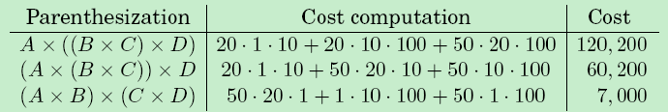
Chain matrix multiplication
Multiply four matrices:A×B×C×D
Depending on how we parenthesize it.
Multiply four matrices:A×B×C×D
A: 50×20 B: 20×1 C: 1×10 D: 10×100

Slide 75
Chain matrix multiplication
the order of multiplications makes a big difference in the final running time!
Compute A1×A2×…×An,
A1: m₀×m₁
A2: m₁×m₂
…
An: m_{n-1}×m_{n}.
How do we determine the optimal order?

Slide 76
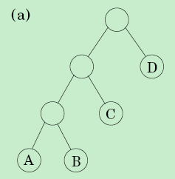
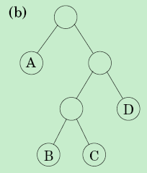
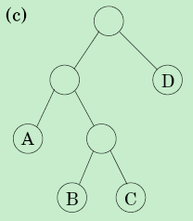
Chain matrix multiplication
Matrix multiplication Binary tree
((A×B)×C)×D
A×((B×C)×D)
(A×(B×C))×D

Slide 77
Chain matrix multiplication
Matrix multiplication Binary tree
for a tree to be optimal, its subtrees must also be optimal.
What are the subproblems corresponding to the subtrees?
A_{i}×A_{i+1}×…×A_{j}
C(i, j)=minimum cost of mulitiplying A_{i}×A_{i+1}×…×A_{j} . 1≤i≤j≤n

Slide 78
Chain matrix multiplication
C(i, j)=minimum cost of mulitiplying A_{i}×A_{i+1}×…×A_{j}. 1≤i≤j≤n
How to get subproblem C(i, j) in terms of smaller subproblems?
for a k between i and j,
A_{i}×…×A_{k} and A_{k+1}×…×A_{j}
C(i, k)
C(k+1, j)
C(i, j) C(i, k) C(k+1, j)
j≥i
C(i, i)=0.
j=i

Slide 79
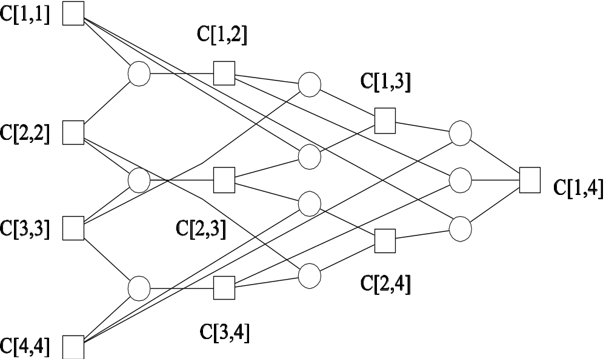
Chain matrix multiplication
C(i, j)=minimum cost of mulitiplying A_{i}×A_{i+1}×…×A_{j}. 1≤i≤j≤n

Slide 80
Chain matrix multiplication
Dpmatrixmul(A1, A2, .., An)
For i=1 to n
C(i, i)=0;
2. For s=1 to n-1 do
for i=1 to n-s do
j=i+s;
C(i, j)=min{C(i,k)+C(k+1, j)+mi-1.mk.mj,
i≤k<j};
3. Return C(1, n).
Running time: O(n³)

Slide 81
例7： All pairs shortest path
For a fixed starting point s, the shortest path from s to other vertices can be found in O(|V||E|) by Bellman-Ford algorithm.
Find shortest path for all pair vertices in given graph.
Straight strategy: run Bellman-Ford algorithm |V| times.
Running time: O(|V|²|E|)
Our objective: O(|V|³)

Slide 82
All pairs shortest path
Is there is a good subproblem for computing distances between all pairs of vertices in a graph?
Shortest path between u, v
u, w1, w2, …, wh, v
Suppose we disallow intermediate nodes altogether.
Then we can solve all-pairs shortest paths at once:
the shortest path from u to v is simply the direct edge (u, v), if it exists.

Slide 83
All pairs shortest path
number the vertices in V as {1, 2, …, n}
let d_{ij}^{(k)} denote the length of the shortest path from i to j in which only use nodes {1, 2, …, k}
Basic idea: construct solution through series of matrices D⁽⁰⁾ , D⁽¹⁾, …, D^{(n)}

Slide 84
All pairs shortest path
D^{(k)} : allow 1, 2, …, k to be intermediate vertices.
How to get subproblem d_{ij}^{(k)} in terms of smaller subproblems?
d_{ik}^{(k-1)}
k
i
d_{kj}^{(k-1)}
d_{ij}^{(k-1)}
j
d_{ij}^{(k)} = min{d_{ij}^{(k-1)} , d_{ik}^{(k-1)} + d_{kj}^{(k-1)}} for k ≥ 1,
d_{ij}⁽⁰⁾ ⁼ w_{ij}

Slide 85
All pairs shortest path
Dpallpairst(G)
For i=1 to n do
for j=1 to n do
d_{ij}⁽⁰⁾= ∞;
2. For all (i,j) ∈E do
d_{ij}⁽⁰⁾=w(i, j);
3. For k=1 to n do
for i=1 to n do
for j=1 to n do
d_{ij}^{(k)} = min{d_{ij}^{(k-1)} , d_{ik}^{(k-1)} + d_{kj}^{(k-1)}}
4. Return D^{(n)}.
Running time: O(n³)

Slide 86
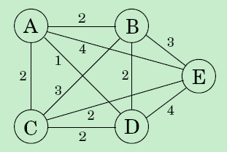
例8： Traveling Salesman
Problem(TSP):
Given a weighted complete graph G=(V, E), where each edge has a weight, find a simple cycle passing through each vertex exactly once and the total weight is minimized.
Brute force: O(n!)

Slide 87
Traveling Salesman
Assume the vertices in G are {1, 2, …, n}
What is the appropriate subproblem for the TSP?
Suppose we have started at city 1 as required, have visited a few cities, and are now in city j.
What information do we need in order to extend this partial tour?
The end vertex j: extend this partial tour
all the cities visited so far

Slide 88


Traveling Salesman
For a subset S {1,2,…,n} such that 1∈S and j∈S.
let C(S, j) be the length of the shortest path visiting each node in S exactly once, starting at 1 and
ending at j.
How to express C(S, j) in terms of smaller subproblems?
C({1},1)=0;

Slide 89
Traveling Salesman
DPTSP(G)
C({1}, 1)=0;
for h=2 to n do
for all subsets S {1,2,…n} of size h and
containing 1 do
C(S,1)= ∞;
for all j ∈S, j ≠1 do
C(S, j)=min{C(S-{j}, i)+d_{ij}, i∈S, i≠j};
3. Return min_{j} C({1,2,..n}, j)+d_{j1}.

Slide 90
Dynamic Programming
  Characterize the structure of an optimal solution
  Find the form of subproblem
  express subproblem in terms of smaller subproblems
  Get the trivial solution
  Give the algorithm based on subproblem expression
  Time analysis

Slide 91
Dynamic Programming Algorithms
  Computing binomial coefficients
  multistage graph problem
  Longest path in DAG
  Edit distance
  Knapsack
  Chain matrix multiplication
  all-pairs shortest paths
  Traveling salesman

